Slide 1

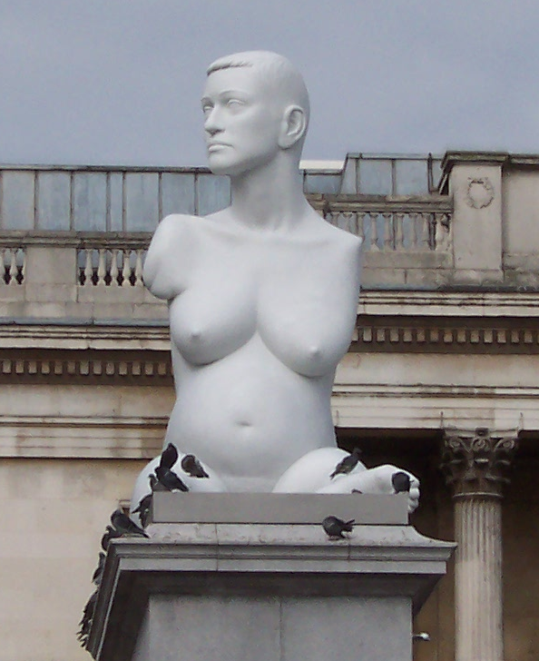
Thalidomide
Learning objectives
Know why thalidomide was banned
Explain the challenges the thalidomide impaired face
Analyse why the tragedy occurred
Starter:
What is different about the person in the picture?
What problems might she have in her daily life?
What might cause this condition?
Notes:
Creative Commons Image Credit: Wikimedia - Sculpture of the painter Alison Lapper created by Mark Quinn

Slide 2
Watch the following video and answer the questions
http://www.youtube.com/watch?v=P5i1HLtLUIc
What is thalidomide?
When was it used (what point in history)?
What was the side effects of taking it?
Who do the “thalidomide babies” (now adults) want compensation from? What is their argument?
These birth defects were a side effect, sometimes called an adverse drug reaction, to Thalidomide.
How do pharmaceutical companies try to ensure that the drugs they sell are safe for the public?

Slide 3
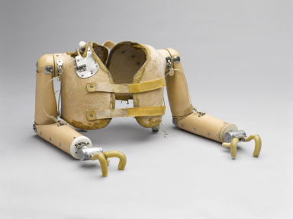

1. How do you think this device was used
2. How would it allow the thalidomide impaired to overcome daily problems?
Notes:
Creative Commons Image Credit: Science Museum London

Slide 4
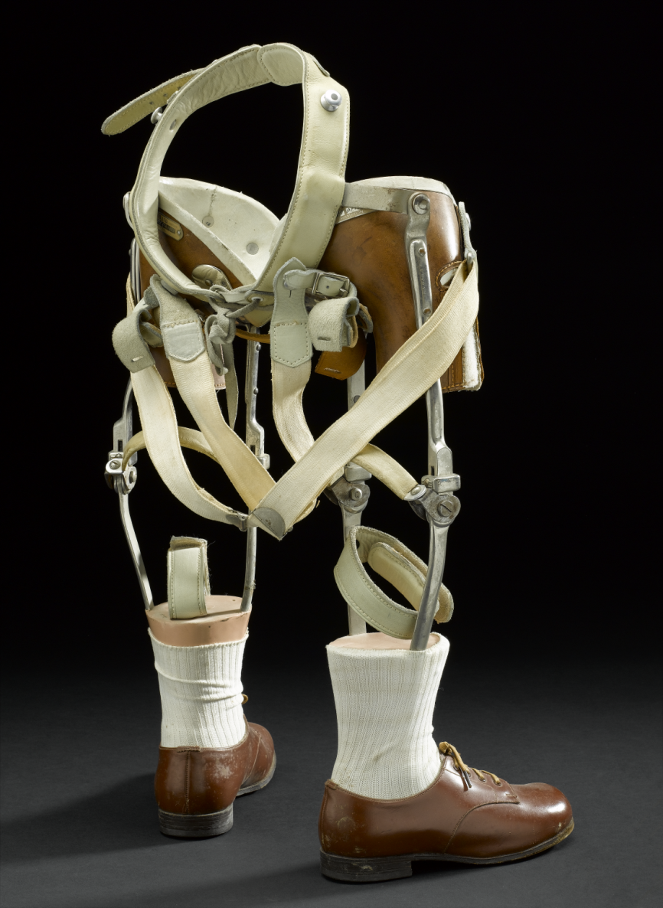
1. How do you think this device was used
2. How would it allow the thalidomide impaired to overcome daily problems?
Notes:
Creative Commons Image Credit: Science Museum London

Slide 5
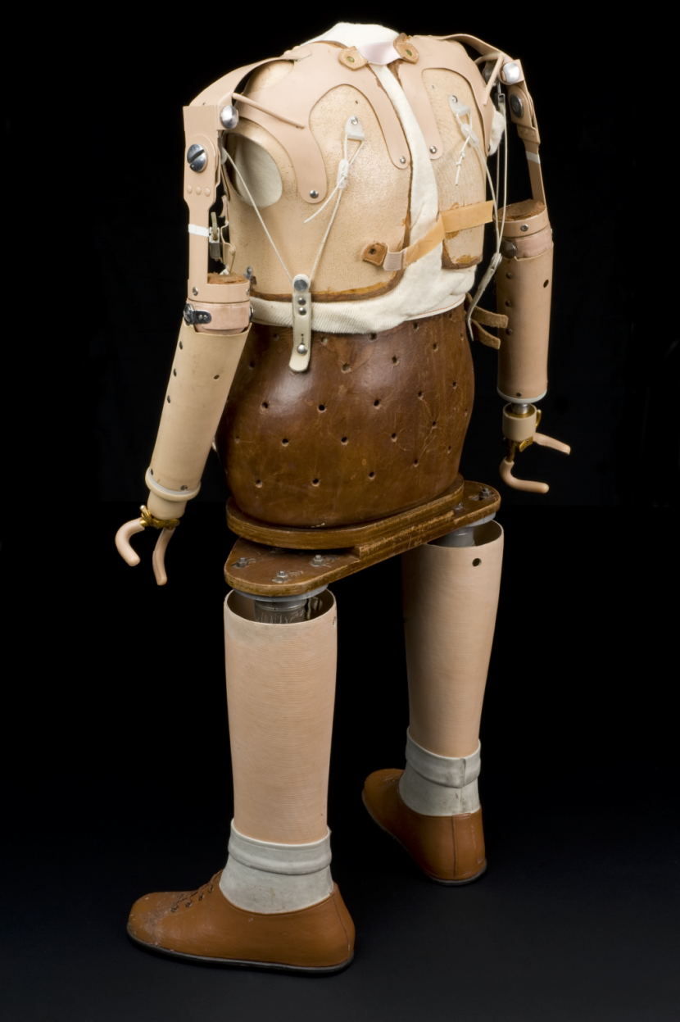
1. How do you think this device was used
2. How would it allow the thalidomide impaired to overcome daily problems?
Notes:
Creative Commons Image Credit: Science Museum London

Slide 6
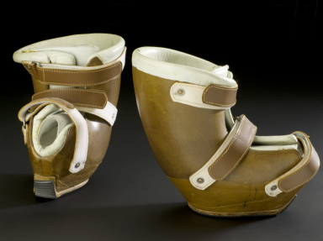
1. How do you think this device was used
2. How would it allow the thalidomide impaired to overcome daily problems?
Notes:
Creative Commons Image Credit: : Science Museum London

Slide 7

Think, Pair, Share: How could you redesign a kitchen to suit the needs of someone who had been born with birth defects as a result of thalidomide
Notes:
Creative Commons Image Credit: User Pbroks13 on WikiCommons

Slide 8
Put the drug development stages in the right order
Drugs are tested on large numbers of patients. Half are given the new drug, half receive a placebo.
Drugs are tested on patients to check that the drug works to treat the disease in people.
Drugs are tested in test tubes and using computers to try to assess if they may be dangerous to humans.
Drugs are tested on a few healthy young men to ensure they are safe and to check for side effects.
Drugs receive a license so doctors can prescribe them to patients
Drugs are tested in two animal species to check that they are not toxic and to find the best dosage
Notes:
Test Tubed
Animals
Health People
Patients
Randomised Trials
Market Release

Slide 9
Answers
Drugs are tested in test tubes and using computers to try to assess if they may be dangerous to humans.
2
3
1
Drugs are tested in two animal species to check that they are not toxic and to find the best dosage
Drugs are tested on a few healthy young men to ensure they are safe and to check for side effects.
Drugs are tested on patients to check that the drug works to treat the disease in people.
5
4
Drugs are tested on large numbers of patients. Half are given the new drug, half receive a placebo.
Drugs receive a license so doctors can prescribe them to patients
6
Notes:
Test Tubed
Animals
Health People
Patients
Randomised Trials
Market Release

Slide 10
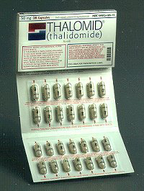
Read the information and answer the question
Thalidomide was tested safe in animals, however pregnant animals were not used because scientists did not, then, believe that drugs taken by the mother would have an effect on the unborn foetus. As a result the side effects were not predicted.
Thalidomide does show teratogenicity (causing birth defects) in many animals and the laws on drug testing were rewritten after the tragedy.
Thalidomide has recently been made available to doctors to treat certain cancers. What precautions do you think doctors should take before prescribing it?
Notes:
Creative Commons Image Credit: User: Duckwailk

Slide 11
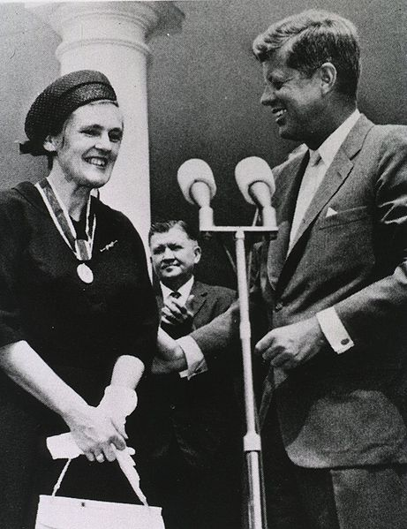
A National Hero
Dr Frances Kelsey worked at the Food and Drug Administration in America in the 1960s. Her first job was to approve thalidomide. Looking at the drug, she was concerned that there might be side effects, especially when reports from Europe suggested women were giving birth to children with physical defects.
Despite pressure from pharmaceutical companies, she refused to approve the new drug. When the connection between thalidomide and birth defects was proved, the drug was banned and America avoided the thalidomide tragedy. Dr Kelsey was heralded as a national hero.
Notes:
Creative Commons Image Credit: http://ihm.nlm.nih.gov/images/A18057

Slide 12

Writing Task
Imagine you work for the Federal Drug Administration like Frances Kelsey. Write a letter to a pharmaceutical company explaining which safety tests or processes you need them to do before you can approve their drug.
Explain why.
Notes:
Creative Commons Image Credit: Antonio Litterio

Slide 13
Plenary
In 15 words or fewer explain why thalidomide was banned.
In three sentences explain some of the difficulties that children with birth defects from Thalidomide face
In one paragraph analyse why thalidomide was approved in the UK despite being dangerous.

Slide 14
Resources

Slide 15

1. How do you think this device was used
2. How would it allow the thalidomide impaired to overcome daily problems?
1. How do you think this device was used
2. How would it allow the thalidomide impaired to overcome daily problems?
Notes:
Image Credit: Credit: Science Museum London

Slide 16

1. How do you think this device was used
2. How would it allow the thalidomide impaired to overcome daily problems?
1. How do you think this device was used
2. How would it allow the thalidomide impaired to overcome daily problems?

Slide 17
Put the drug development stages in the right order
Drugs are tested on large numbers of patients. Half are given the new drug, half receive a placebo.
Drugs are tested on patients to check that the drug works to treat the disease in people.
Drugs are tested in test tubes and using computers to try to assess if they may be dangerous to humans.
Drugs are tested on a few healthy young men to ensure they are safe and to check for side effects.
Drugs receive a license so doctors can prescribe them to patients
Drugs are tested in two animal species to check that they are not toxic and to find the best dosage
Notes:
Test Tubed
Animals
Health People
Patients
Randomised Trials
Market Release

Slide 18
Answers
Drugs are tested in test tubes and using computers to try to assess if they may be dangerous to humans.
2
3
1
Drugs are tested in two animal species to check that they are not toxic and to find the best dosage
Drugs are tested on a few healthy young men to ensure they are safe and to check for side effects.
Drugs are tested on patients to check that the drug works to treat the disease in people.
5
4
Drugs are tested on large numbers of patients. Half are given the new drug, half receive a placebo.
Drugs receive a license so doctors can prescribe them to patients
6
Notes:
Test Tubed
Animals
Health People
Patients
Randomised Trials
Market Release

